Slide 1
Data Cleansing with Pig Latin

Slide 2
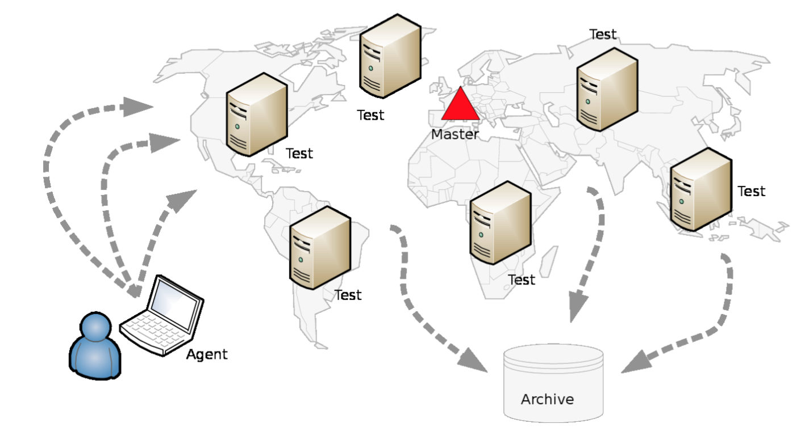
Neubot Tests

Slide 3
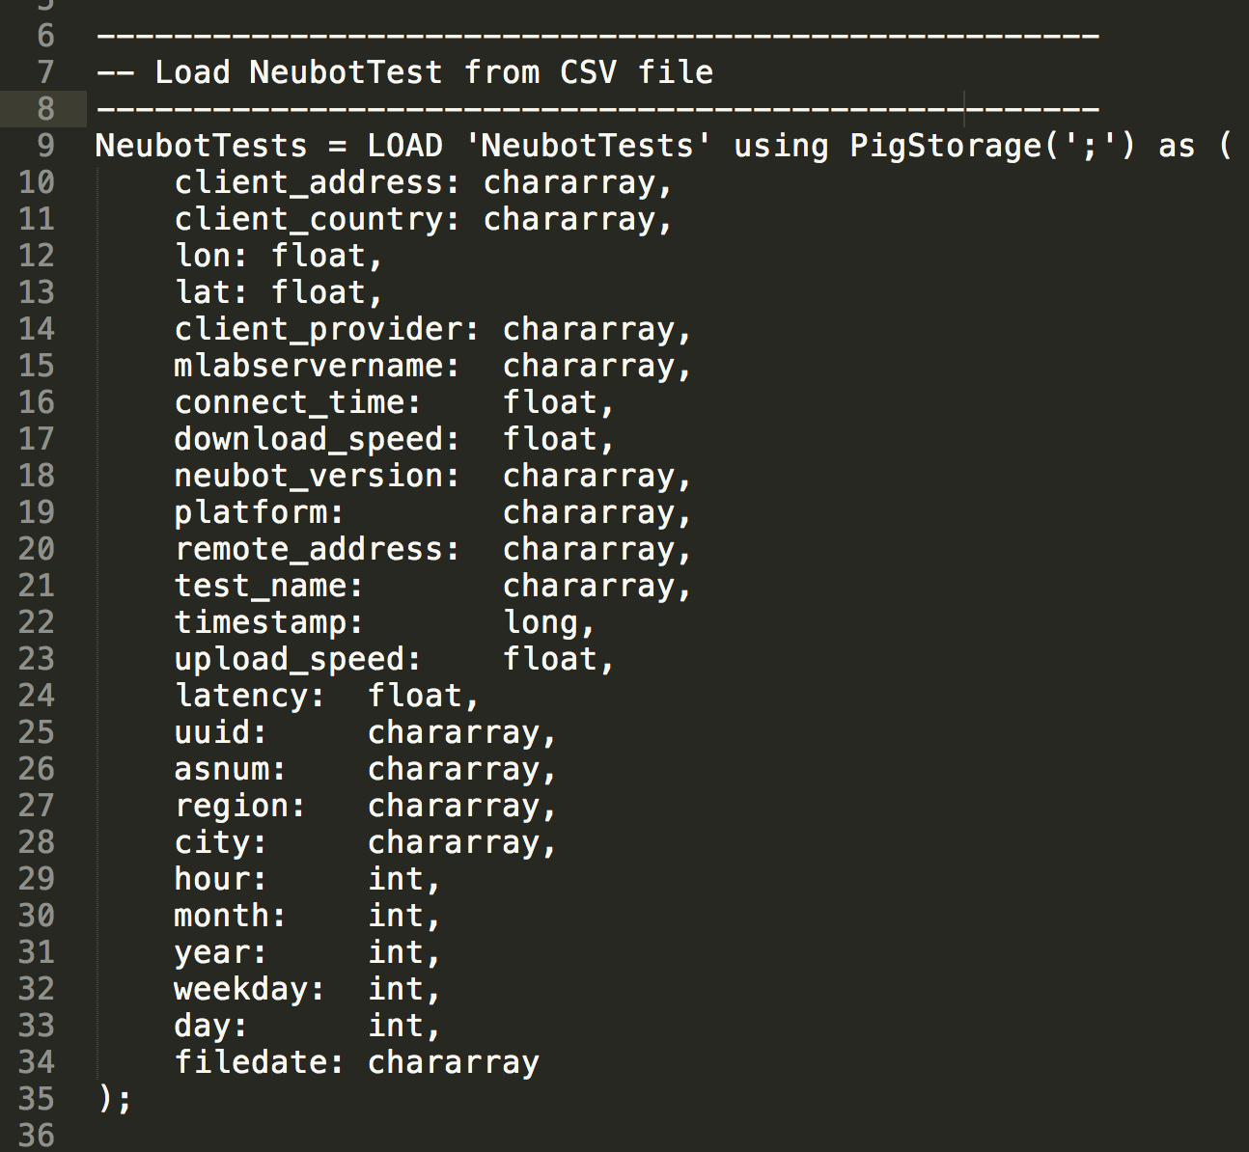
Data Structure

Slide 4
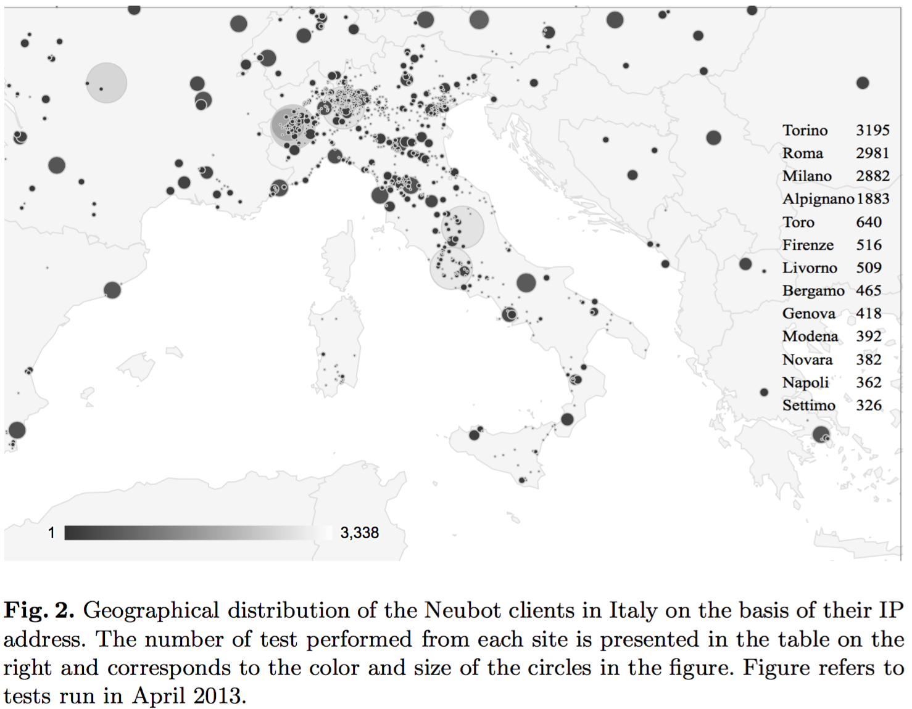
Example

Slide 5
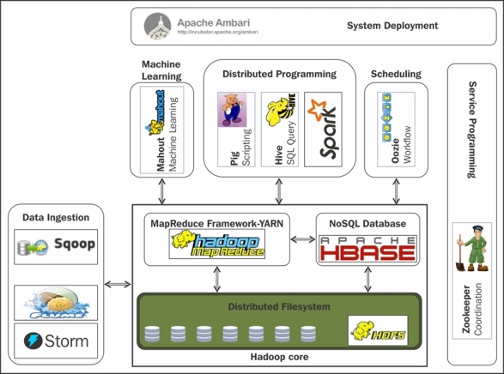
Hadoop Ecosystem

Slide 6
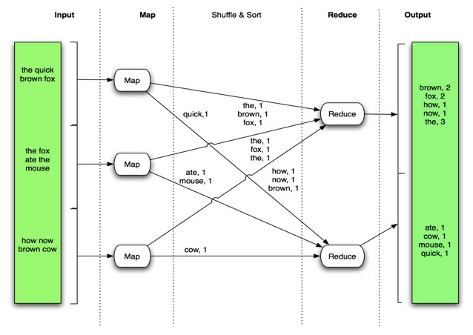
MapReduce
Source: http://www.slideshare.net/hadoop/practical-problem-solving-with-apache-hadoop-pig

Slide 7
Pig Latin
High level data flow language for exploring very large datasets.
Provides an engine for executing data flows in parallel on Hadoop.
Compiler that produces sequences of MapReduce programs
Structure is amenable to substantial parallelization
Operates on files in HDFS
Metadata not required, but used when available
Key Properties of Pig:
Ease of programming: Trivial to achieve parallel execution of simple and parallel data analysis tasks
Optimization opportunities: Allows the user to focus on semantics rather than efficiency
Extensibility: Users can create their own functions to do special-purpose processing

Slide 8
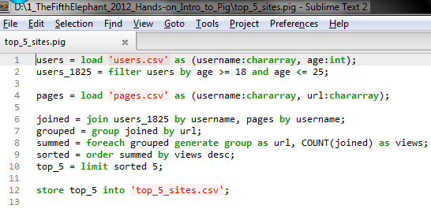
Why Pig?

Slide 9
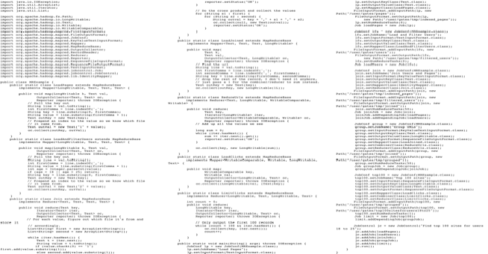
Equivalent Java MapReduce Code

Slide 10
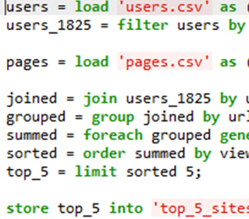
Load Users
Load Pages
Filter by Age
Join on Name
Group on url
Count Clicks
Order by Clicks
Take Top 5
Save results

Slide 11
Pig Datatypes
Simple Type
int
long
float
double
chararray
bytearray
boolean
Type | Description
tuple | An ordered set of fields.
bag | An collection of tuples.
map | A set of key value pairs.

Slide 12
Pig Simple Datatypes
Simple Type | Description | Example
int | Signed 32-bit integer | 10
long | Signed 64-bit integer | Data: 10L or 10l Display: 10L
float | 32-bit floating point | Data: 10.5F or 10.5f or 10.5e2f or 10.5E2F Display: 10.5F or 1050.0F
double | 64-bit floating point | Data: 10.5 or 10.5e2 or 10.5E2 Display: 10.5 or 1050.0
chararray | Character array (string) in Unicode UTF-8 format | hello world
bytearray | Byte array (blob)
boolean | boolean | true/false (case insensitive)

Slide 13
Pig Commands
Statement | Description
Load | Read data from the file system
Store | Write data to the file system
Dump | Write output to stdout
Foreach | Apply expression to each record and generate one or more records
Filter | Apply predicate to each record and remove records where false
Group / Cogroup | Collect records with the same key from one or more inputs
Join | Join two or more inputs based on a key
Order | Sort records based on a Key
Distinct | Remove duplicate records
Union | Merge two datasets
Limit | Limit the number of records
Split | Split data into 2 or more sets, based on filter conditions

Slide 14
Pig Diagnostic Operators
Statement | Description
Describe | Returns the schema of the relation
Dump | Dumps the results to the screen
Explain | Displays execution plans.
Illustrate | Displays a step-by-step execution of a sequence of statements

Slide 15
Architecture of Pig
Grunt (Interactive shell)
PigServer (Java API)
PigContext
Parser (PigLatin→LogicalPlan)
Optimizer (LogicalPlan → LogicalPlan)
Compiler (LogicalPlan → PhysicalPlan → MapReducePlan)
ExecutionEngine
Hadoop

Slide 16
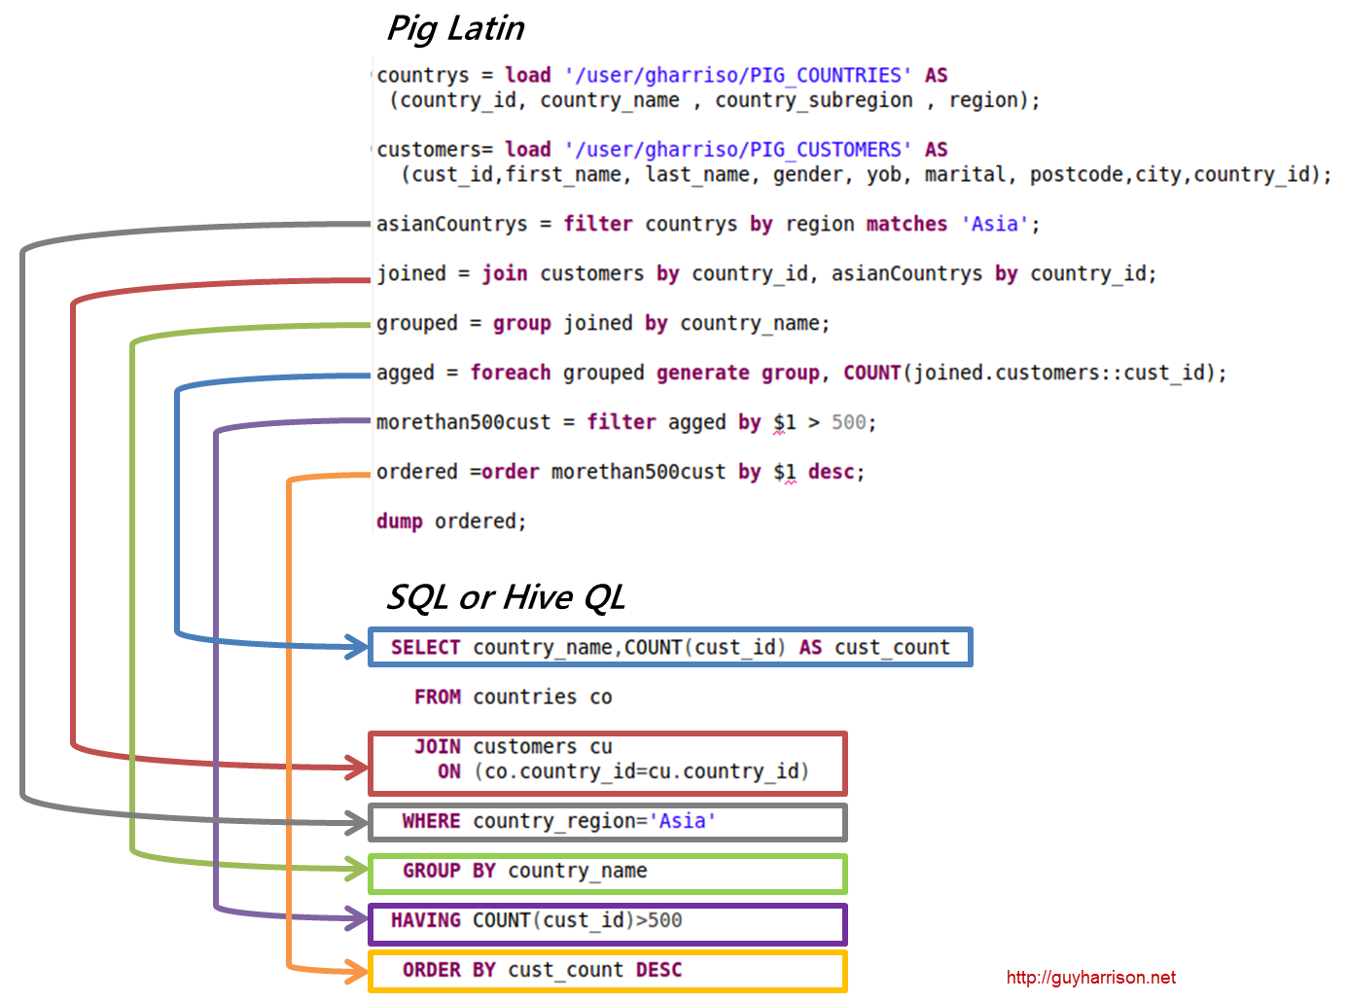
Pig Latin vs SQL

Slide 17
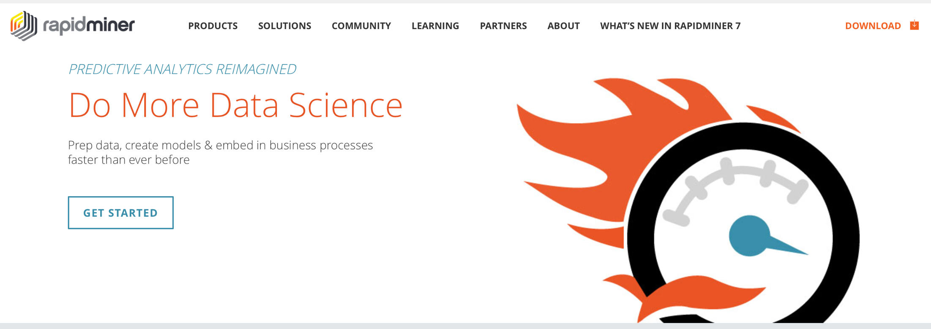
RapidMiner

